Slide 1


K.RAMAKRISHNAN COLLEGE OF TECHNOLOGY (AUTONOMOUS), TRICHY R PROGRAMMING
CREATING A SHINY APP TO DISPLAY WEATHER TRENDS IN YOUR CITY
PRESENTED BY
TAMILDEEPAA A -2303811724322116

Slide 2
PRESENTATION OVERVIEW
PROBLEM IDENTIFICATION
OBJECTIVE
PROPOSED SYSTEM
BLOCK DIAGRAM OF PROPOSED SYSTEM
R USED
ADVANTAGES

Slide 3
PROBLEM IDENTIFICATION
Weather trends impact daily life, agriculture, and urban planning
Existing apps focus on current conditions, lacking historical trend analysis.
Need for an interactive system to visualize long-term weather trends.
Unpredictable weather patterns can affect transportation, health, and outdoor activities.
Lack of user-friendly tools to analyze weather data over different time frames.

Slide 4
OBJECTIVE
Develop a Shiny app for exploring and analyzing city weather trends.
Provide interactive visualizations of temperature, humidity, and precipitation.
Enable informed decision-making with historical and real-time weather data
Support better planning for businesses, individuals, and local authorities.

Slide 5
PROPOSED SYSTEM
BLOCK DIAGRAM
User Interface: Users can input location details to fetch weather information.
Server Logic: Communicates with weather APIs or databases.
Fetching Weather Data: Collects real-time and historical weather data such as temperature, humidity, wind speed, and precipitation.
Processing Data: Applying algorithms for weather pattern recognition.
Data Visualization: Different visual representations such as bar charts, line graphs, and heat maps.

Slide 6
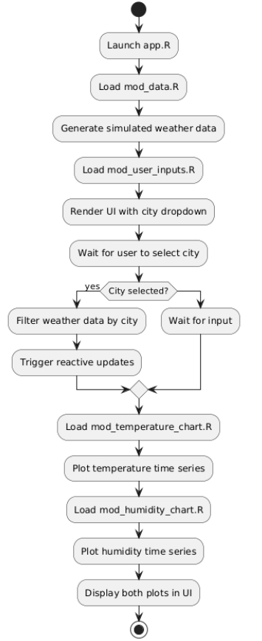
PROPOSED SYSTEM
BLOCK DIAGRAM

Slide 7
R USED
Vectors: Store temperature, humidity, and precipitation data.
Lists: Hold multiple data types like city names, timestamps, and weather parameters.
Data Frames: Organize structured weather data for analysis and visualization.
Matrices: Handle multi-dimensional weather attributes.
.

Slide 8
ADVANTAGES OF PROPOSED SYSTEM
Real-Time Insights: Provides up-to-date weather trend analysis.
Historical Data Analysis: Allows users to compare past and present weather conditions.
Interactive Visualizations: Enhances user experience with dynamic graphs and charts.
Customizable Analysis: Users can select specific parameters and timeframes.
Predictive Capabilities: Machine learning models help forecast future weather trends.

Slide 9
LIST OF MODULES
mod_data.R
mod_user_inputs.R
mod_temperature_chart.R
mod_humidity_chart.R
app.R

Slide 10
MODULE DESCRIPTION
mod_data.R :
Generates sample weather data for multiple cities. Used as the data backend for the entire app.
mod_user_inputs.R :
Creates the user interface for selecting a city and triggering the display. Encapsulates city dropdown and "Show Weather" button.

Slide 11
MODULE DESCRIPTION
mod_temperature_chart.R :
Displays the temperature trend for the selected city. Uses ggplot2 to render a time-series line chart.
mod_humidity_chart.R :
Displays the humidity trend for the selected city. Similar to the temperature module but for humidity data.

Slide 12
MODULE DESCRIPTION
app.R :
Main application file that stitches all modules together. Launches the Shiny app with a sidebar and main plot panel layout.

Slide 13
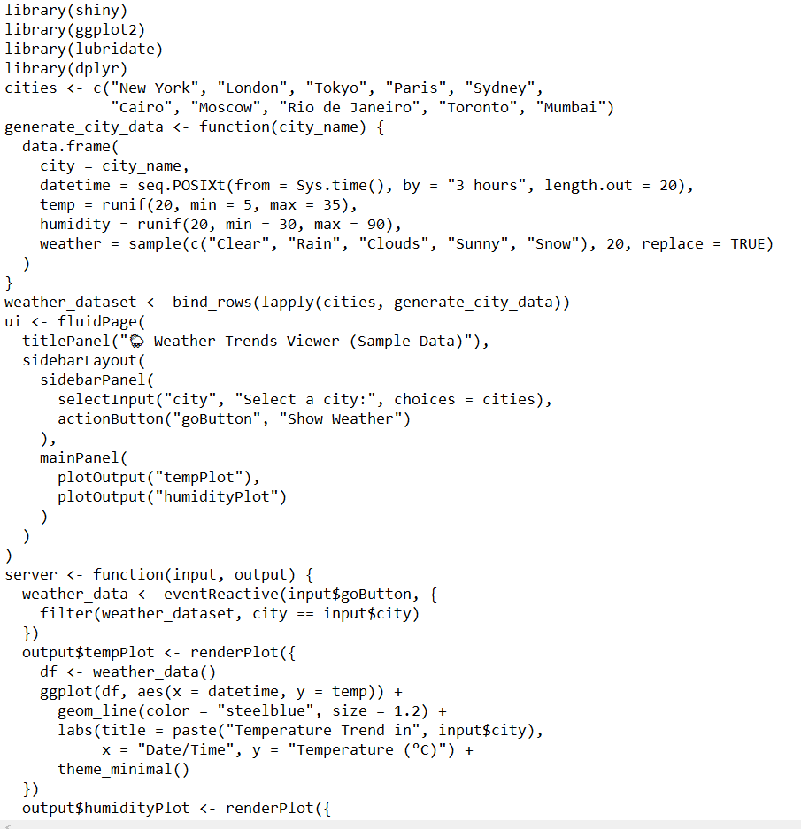
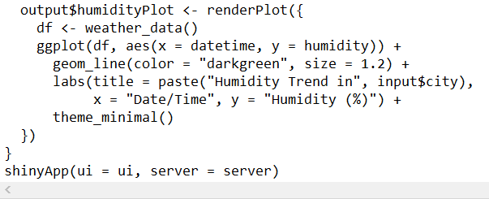
IMPLEMENTATION

Slide 14
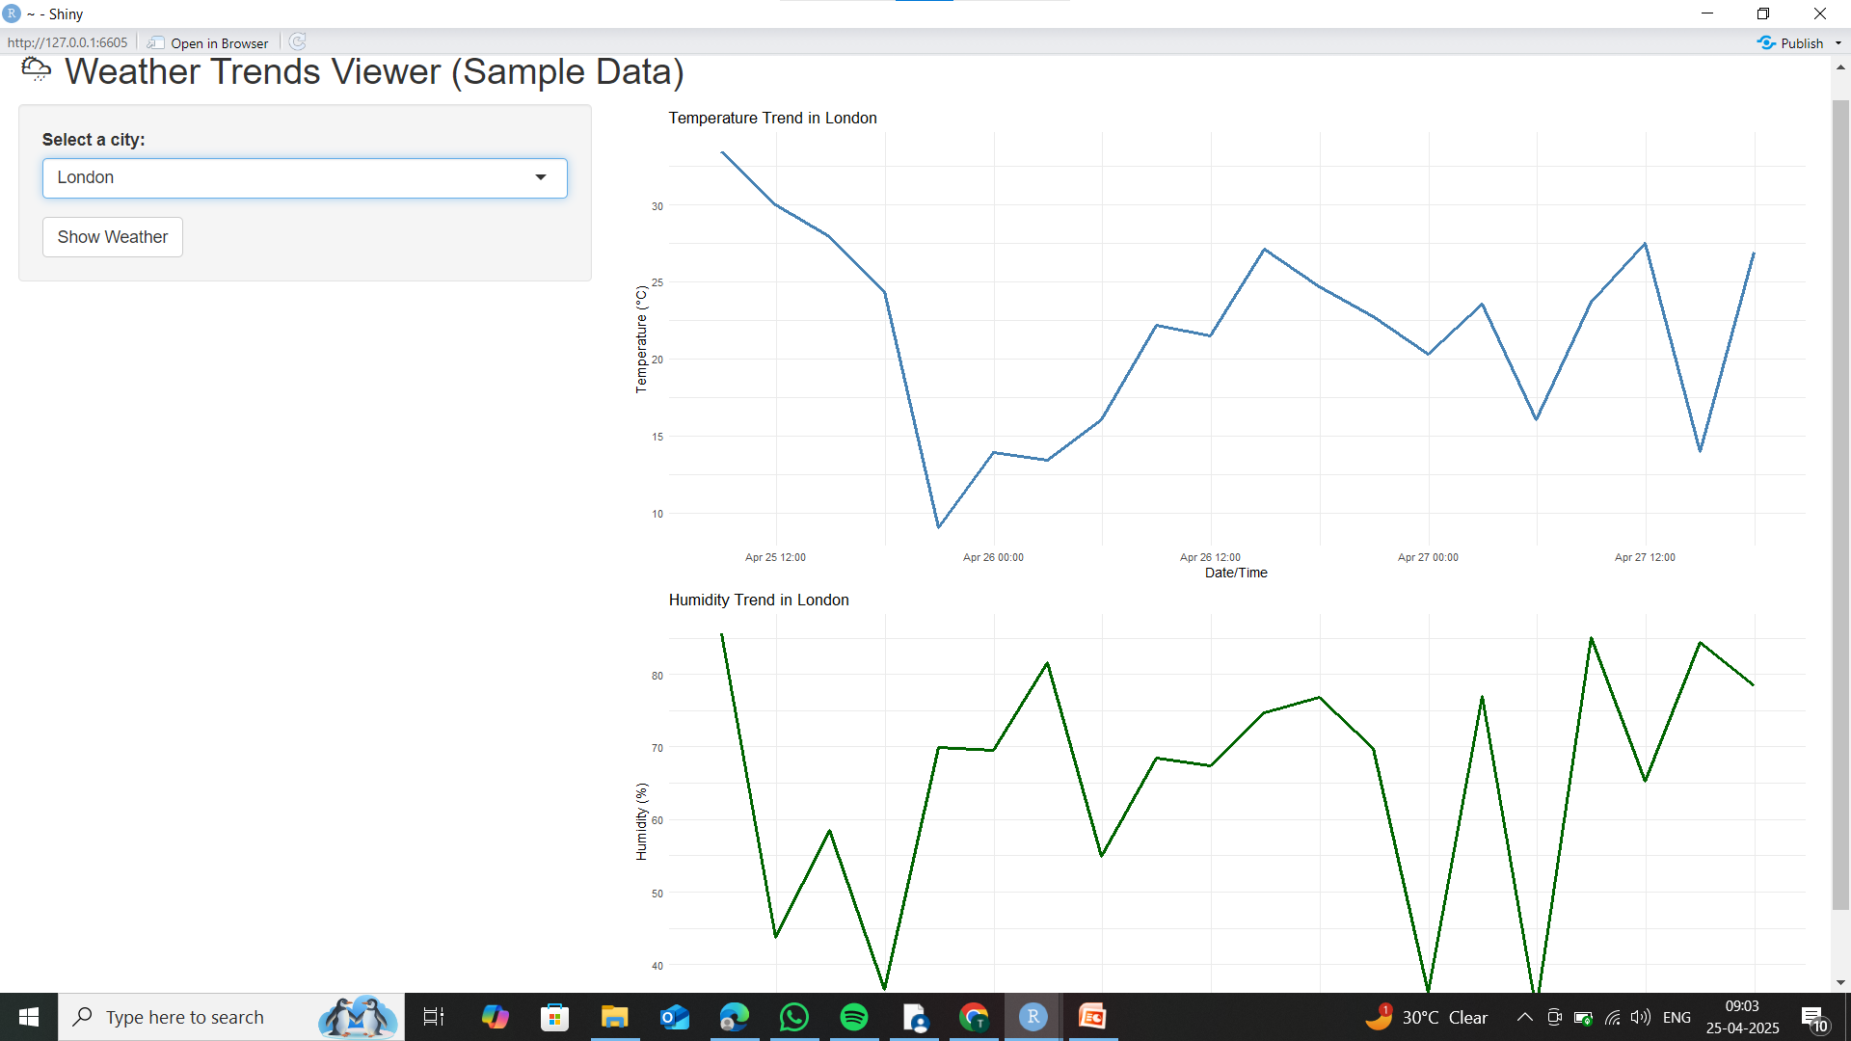
OUTPUT

Slide 15
CONCLUSION
This modular Shiny app displays temperature and humidity trends for 10 cities using simulated data. By separating the code into UI, server, and reusable plot modules, the app is clean, scalable, and easy to maintain. It works offline and provides an interactive way to explore weather patterns — a solid foundation for future enhancements or API integration.

Slide 16


